Slide 1
WELCOME

Slide 2
DOCTOR’S APPOINTMENT PROGRAM IN C++
GANPAT UNIVERSITY
CSE CBA
PPT BY RISHABH MALOO
21162101023
ESSENTIAL OF SOFTWARE FOUNDATION & PROGRAMMING-II
ACKNOWLEDGED BY PROF RAJESH K. JHA & UMANG R. THAKKAR

Slide 3
CONCEPTS IN PROGRAM
HEADER FILE ➔ iostream, string, fstream , cstring .
CLASS & OBJECT
FILE HANDLING
LOOPS
USER-DEFINED FUNCTIONS
void bookAppointment()
void existingAppointment()
BUILT-IN FUNCTION
int main()
getline()
getchar()

Slide 4
HEADER FILES
iostream: iostream stands for standard input-output stream. This header file contains definitions of objects like cin, cout ,etc.
string.h : This header file contains macro definitions, constants and declarations of functions and types used not only for string handling but also various memory handling function
fstream : This is used to both read and write data from file.
cstring : The cstring header file contains definitions for C++ for manipulating several kinds of strings . cstring tracks the length of character data so that it can more securely watch the data and the space it requires .

Slide 5
Concepts used in program
Class & Object : A class is defined in C++ using keyword class followed by the name of class. The body of class is defined inside the curly brackets and terminated by a semicolon at the end. Declaring Objects: When a class is defined, only the specification for the object is defined; no memory or storage is allocated.
File Handling : File handling in C++ is a mechanism to store the output of a program in a file and help perform various operations on it. Files help store these data permanently on a storage device.
Loops :
if ➔if statement is the most simple decision-making statement. It is used to decide whether a certain statement or block of statements will be executed or not
else ➔We can use the else statement with if statement to execute a block of code when the condition is false.
while ➔ A while loop evaluates the condition. If the condition evaluates to true , the code inside the while loop is executed. The condition is evaluated again. This process continues until the condition is false .

Slide 6
USER -DEFINED FUNCTIONS
void bookAppointment(): This function will be execute for purpose like booking the appointment while showing the list of available appointments .
variables defined in void bookAppointment are as follows:
ifstream – ifs , read.
int – hoursbook , arr[13] , recordFound , i , index , hours , isBooked.
char – key , temp , choice .
string – name .
ofstream – out
void existingAppointment(): This function will check if record already exist or not .
It will show the list of appointments available for booking and the appointments which had been booked.
Note : I had used an file naming appointment.txt in which our data will be stored and can get appended .

Slide 7
BUILT-IN FUNCTIONS
int main() : 'int main' means that our function needs to return some integer at the end of the execution and we do so by returning 0 at the end of the program. 0 is the standard for the “successful execution of the program” .
getline () : ‘getline’ is an in-built function defined in the <string. h> header file that allows accepting and reading single and multiple line strings from the input stream.
getchar() : ’ getchar’ function is equivalent to a call to getc(stdin). It reads the next character from stdin which is usually the keyboard .

Slide 8
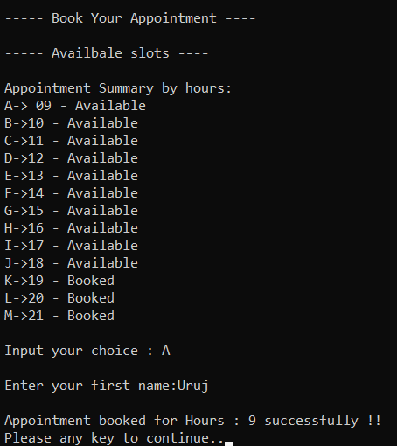
This shows the output for booking an appointmnet

Slide 9
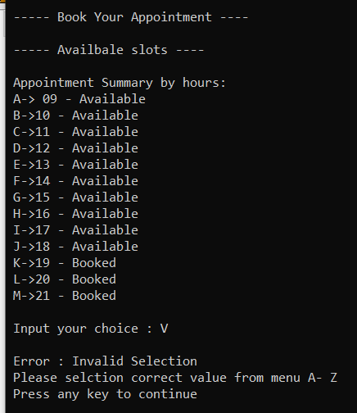
Invalid selection of data which will result in error showing

Slide 10
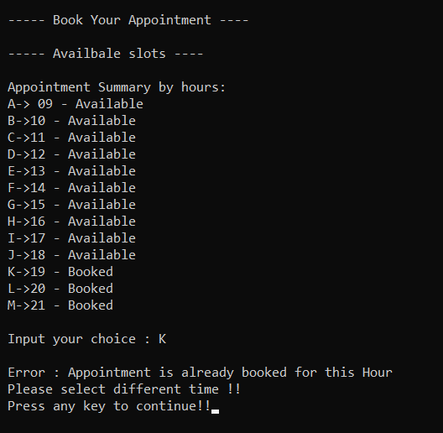
This will show if data user want to
add data once again for same time.

Slide 11
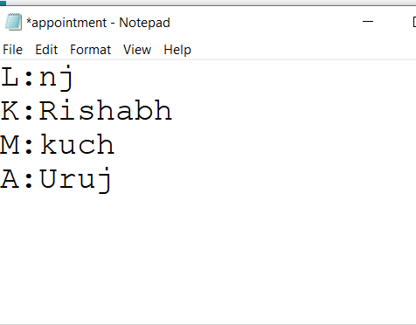
Data stored in text file appointment.txt

Slide 12
Thank you

